Slide 1
POLITICIAN 360
MOHD FAISAL RAZA,
SOHAIB AHMAD,
RODRIGO SERVIUC PAVEZI,
SUMITA DHANASEKARAN,
ARUN KISHORE RAJENDARAN

Slide 2
Vision
Collect and analyse news and social networks to provide a linked information and a rank of Irish politicians by popularity and sentiment analyses.

Slide 3
Why Politician 360
We believe that anyone interested in Irish Politics would like to know better what the news and social networks are saying about Irish politicians.
A rank could be a good indicator of which politician is most popular and what the general opinion thinks about them, specially with the sentiment indicator.
There is no such system with this information built ever.

Slide 4
Who will use it?
Voters
News Agencies
Politics students and researchers

Slide 5
How will they use it?
Users could use the Irish politician latest news and tweets section for having a easy way to get this specific information instead of looking at the web trying to find the related news by themselves.
Users could use the TOP 10 popularity rank to easily know what are the most popular politicians.
User could use the rank by popularity to compare politicians and know which politician is being talked about more or less on the news.

Slide 6
How will they use it?
Users could use the politician information page to know more about a specific politician.
What news and tweets have a relation with him?
How does he look like(Photo)?
What is his party and constituency?
Is he a senator or deputy?

Slide 7
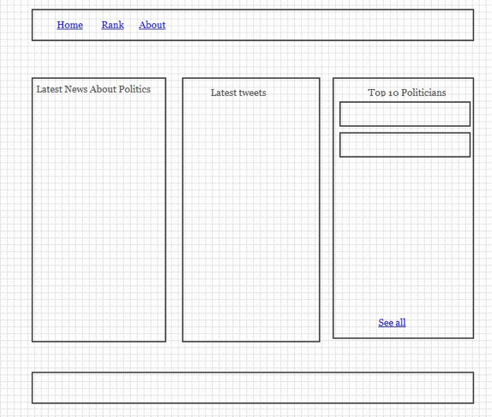
Home page

Slide 8
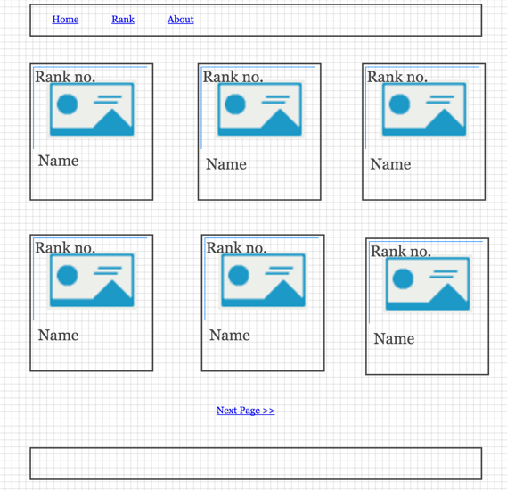
Rank page

Slide 9
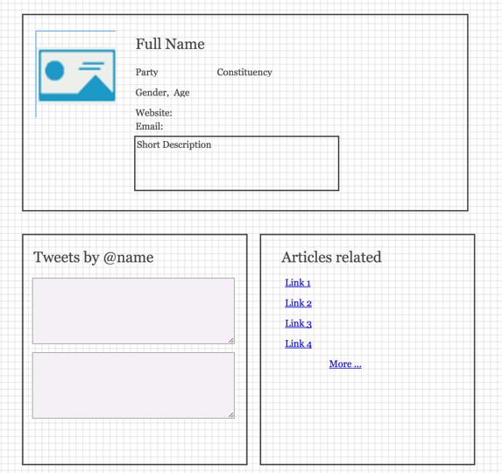
Politician page

Slide 10
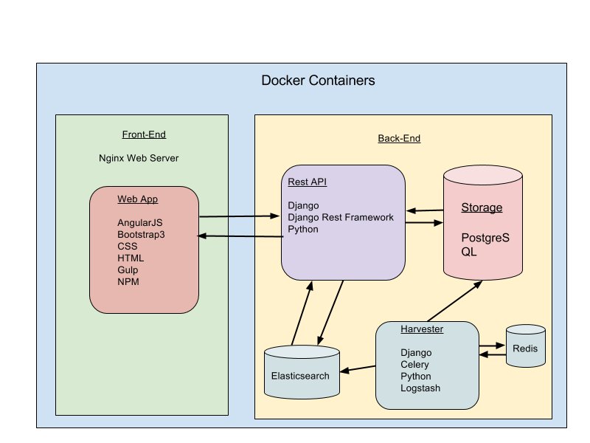
Technology Stack

Slide 11
Data Stack
News papers
RTE NEWS
IRISH EXAMINER
THE IRISH TIMES
IRISH DEPENDENT
THE JOURNAL.IE
NEWSTALK
Twitter
Stream API
Search API

Slide 12
Data Stack - News Papers
Read RSS feeds and collect those that have a relation with a politician.
Search for news related to a politician direct on the news website.
Use entity disambiguation technics.

Slide 13
Data Stack - Twitter
Use Search API to get tweets for specific politicians.
Listen for the Stream API and collect tweets that are related to politicians
All tweets are going to be indexed

Slide 14
Evaluation
We will measure how useful the application is for the users. The idea is to assess people's knowledge about Irish Politicians when using the open web or our system.
Our system should be able to give more info about a politician in a certain period of time, such as 10 minutes, than looking on the web.
We can also add social network sharable links and count the number of shares.
We will also validate if our system is identifying and disambiguating entities accurately.

Slide 15
Key Challenges
To avoid Disambiguity in the name of the politician
To find the correct sentiment of a news or tweet
To find the RSS feeds that are related to specific politicians

Slide 16
Current Prototype
A deployed system using Docker Compose
A backend implementing a Rest API in Django and using PostgresSql
A frontend implementing a UI in AngularJS
http://csi6220-2-vm2.ucd.ie/

Slide 17
What Next?
Implement the RSS collector
Implement the Tweets collector
Implement the Politician Details page which will show the news and tweets related to a particular politician

Slide 18
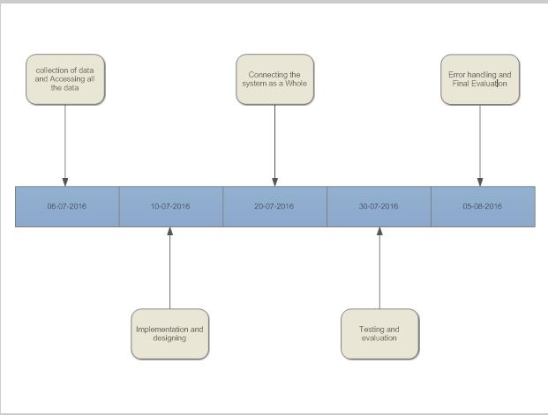
Project Roadmap :-

Slide 19
Any Question ?
Feel free to give Suggestions to anyone of our team members

Slide 20
THANKS

